Slide 1
Organizing Life’s Diversity
Chapter 17

Slide 2
Why do biologists classify all living things?
To organize living things by shared characteristics
To help to understand relationships between organisms

Slide 3
Why do biologists classify all living things?
5 to 50 million species on earth
Only 1.5-2 million identified
Where are the majority of earth’s species found?

Slide 4
How are animals grouped at the zoo?
Old Method
New Method
Cages
$$
Free to move
Looks like environment

Slide 5
17.1 Classification
The grouping of objects or information based on similarities
Taxonomy – the branch of biology that groups and names organisms

Slide 6
Work with your partner to list 5 things that you classify (or that you could classify)
  Ex. clothes
Choose one of your examples, explain in detail your classification system
  Ex. Type, color, season

Slide 7
History of Classification
Aristotle (300s B.C.) – developed first method
2 groups:
  Plants Animals
    size habitat (land, water, air)
    structure w/blood, w/o blood
    herbs, shrubs, trees

Slide 8
History of Classification
Carolus Linnaeus (mid 1700s) – developed system we use today
Based on physical characteristics

Slide 9
Binomial Nomenclature
2 word naming system
Genus species
  Genus – group of similar species
  species – describes a characteristic
    Also called specific epithet

Slide 10

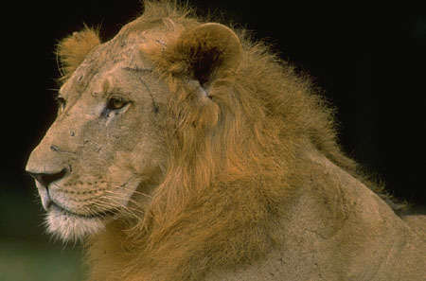
Binomial Nomenclature
Felis domestica
Panthera leo (Felis leo)

Slide 11
Why do we use scientific names?
Gives exact name of organism
Use Latin to name organism
No longer spoken so it does not change

Slide 12
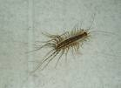

Why do we use scientific names?
Common names can be misleading
    Ex. silverfish
    Lepisma saccharina Scutigera coleoptrata

Slide 13
Why do we use scientific names?
Organisms can have multiple common names
Common names can vary by country, state, or even county

Slide 14
QUIZ
What is the name of the system of classification that was originally developed by Linnaeus?
What is one problem with using the common names of organisms?
How many species have been identified?

Slide 15
Taxonomy – A Useful Tool
Implications to agriculture, forestry, medicine
Identify poisonous species
  Mushrooms, berries, snakes

Slide 16
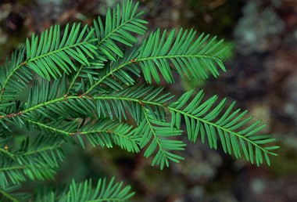
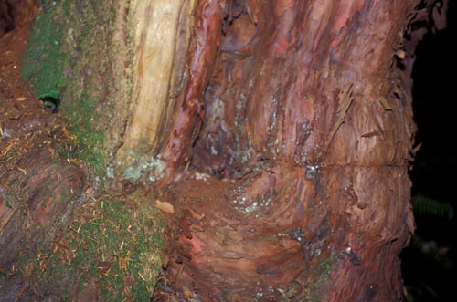
Economic Importance
Drugs: Taxol from the Pacific Yew (Taxus brevifolia)

Slide 17
How are living things classified?
Categorized into groups called taxa (sing. taxon)

Slide 18
8 Taxonomic Rankings
Organisms ranked in taxa from broad characteristics to specific characteristics
Pg.449

Slide 19
8 Taxonomic Rankings
Domain (general, many species)
  Kingdom
    Phylum
      Class
        Order
          Family
            Genus
              Species (specific, one species)

Slide 20
8 Taxonomic Rankings
To help you remember the taxa in order:
Do Kings Play Cards On
Fat Green Stools?

Slide 21
Human Classification
Category | Name | Defining Characteristic
Domain
Kingdom
Phylum
Class
Order
Family
Genus
Species

Slide 22
Category | Example 1 | Example 2 | Example 3
Domain: | Eukarya | Eukarya | Eukarya
Kingdom: | Animalia | Animalia | Animalia
Phylum: | Chordata | Chordata | Chordata
Class: | Mammalia | Mammalia | Mammalia
Order: | Carnivora | Carnivora | Carnivora
Family: | Canidae | Felidae | Felidae
Genus: | Canis | Felis | Panthera
Species: | familiaris | concolor | tigris
Common Name:

Slide 23
How can YOU classify an organism?
Dichotomous Key – a set of paired statements that can be used to identify organisms
  Each pair of statements direct you to another statement until the name or taxa the organism belongs to is identified

Slide 24
Interpreting Graphics - Taxonomy
Taxonomy - Interpreting Graphics
http://www.biologycorner.com/worksheets/taxonomy_interpret.html

Slide 25
1. ______ Dogs belong to the order Felidae.
2. ______ A fox belongs to the phylum Arthropoda.
3. ______ Snakes belong to the phylum Reptilia.
4. ______ Lions belong to the class mammalia
5. ______ All arthropods belong to the Class Insecta
6. ______ All rodents belong to the phylum chordata.
7. ______ All amphibians belong to the class reptilia.
8. _______ All primates are mammals.
9. _______ The class mammalia includes dogs, cats and rats.
10. ______ A lion belongs to the genus Felis.
11. ______ All mammals are primates.
12. ______ Insects and lobsters are arthropods.

Slide 26
In each set, circle the pair that is most closely related.
13. snakes & crocodiles | snakes & frogs
14. rats & cats | cats & dogs
15. insects & lobsters | insects & birds
16. lions & tigers | lions & cougars
17. foxes & rats | foxes & dogs
18. cats & dogs | cats & lions
19. List (use species name) all the animals pictured that belong in the Felidae family.
20. The image does not show orders of insects. Suggest three categories of insects that would likely be grouped into orders. Hint: think about what kind of insects there are. Add your three categories to the image.

Slide 27
17.2 The Six Kingdoms
Evolutionary relationships are determined based on similarities in:
  structure
  breeding behavior
  geographical distribution
  chromosomes
  biochemistry

Slide 28
1. Structural Similarities
Shared characteristics implies a common ancestor (species are closely related)
  Ex. Retractable claws → cat family
  Ex. Thumbs → primate
  Ex. Dandelions & sunflowers

Slide 29
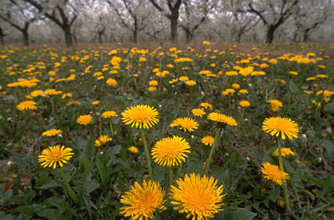



Dandelions: Sunflowers:
Both in family Asteraceae

Slide 30
2. Breeding Behavior
Each species has a distinct mating season, rituals and ways of attracting mates
  Ex. Similar frogs with different sounds to attract mates

Slide 31
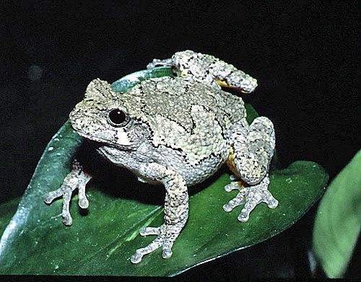
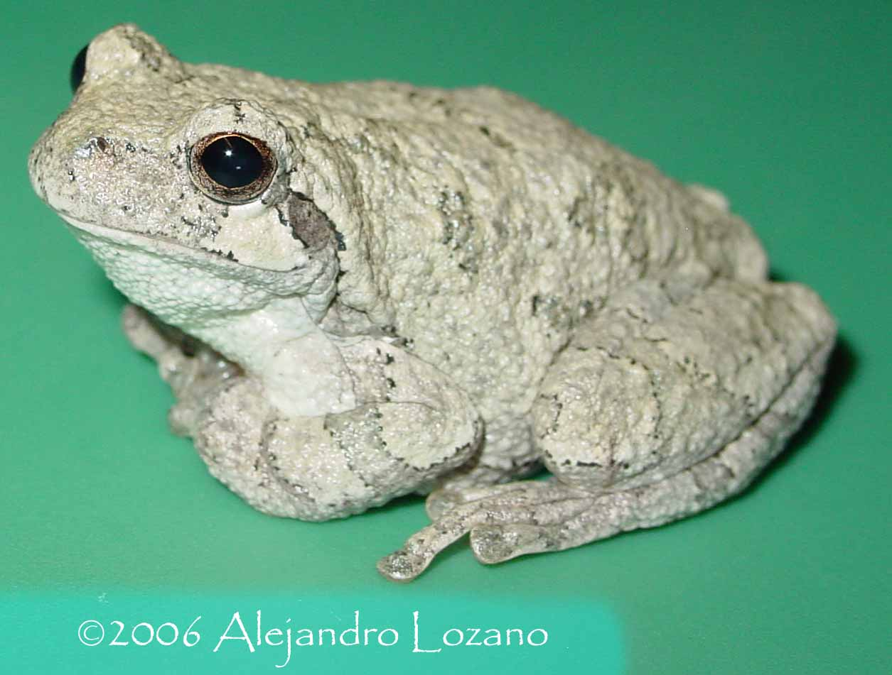
Hyla versicolor Hyla chrysoscelis
Both are called by the same common
name, the gray treefrog

Slide 32
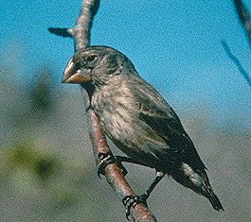
3. Geographical distribution
Species may evolve into many species if isolated
  Ex. Galapagos Island finches

Slide 33
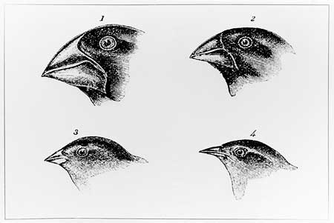
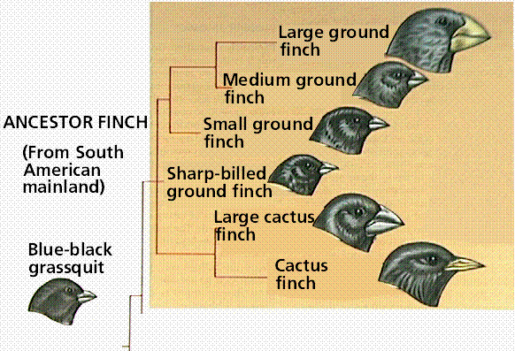
Darwin’s finches

Slide 34
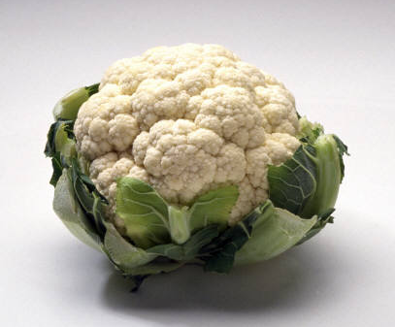
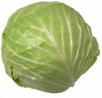

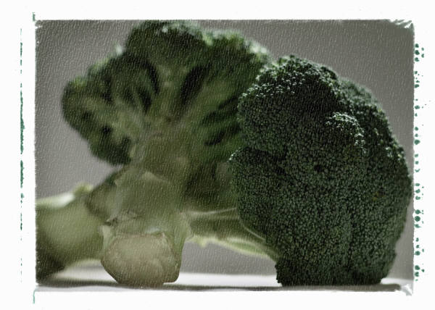
4. Chromosome Comparisons
Number and structure of chromosomes
  Ex. Cauliflower, cabbage, kale and broccoli

Slide 35
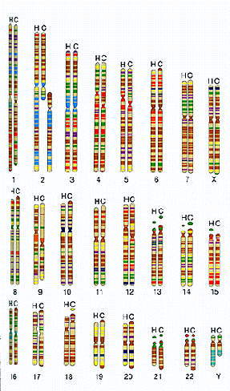
  Ex. Chimps, humans, gorillas

Slide 36
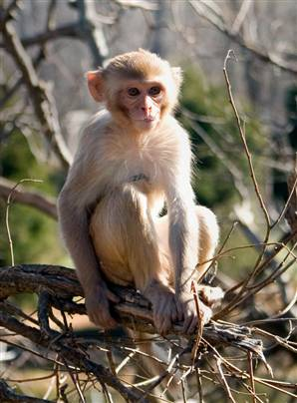
5. Biochemistry
Similar DNA sequences will result in similar proteins
  Protein that determines
  rh factor in human blood
  (+ or -) was first found in
  the Rhesis monkey

Slide 37
Phylogenetic Classification
Phylogeny – the evolutionary history of a species

Slide 38
Cladistics
One system of classification based on phylogeny

Slide 39
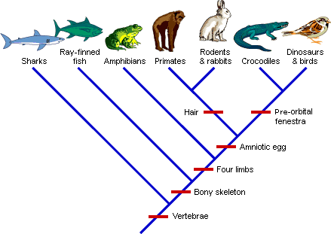
Cladogram of vertebrates

Slide 40
The Six Kingdoms
Archaebacteria
Eubacteria
Protista
Fungi
Plantae
Animalia
Prokaryotes:
-microscopic, unicellular organisms
-no membrane-bound nucleus
Eukaryotes:
-cell(s) have a membrane-bound nucleus and organelles

Slide 41
How are organisms placed into their kingdom?
Cell type
(prokaryotic/eukaryotic)
Methods of obtaining food/energy
(autotrophic/heterotrophic)
Number of cells (unicellular/multicellular)

Slide 42
Archaebacteria
Number identified species: 300
Found in extreme environments: swamps, hydrothermal vents (no oxygen)
Prokaryotic, cell walls, only single celled
Chemosynthetic (make food from chemicals)

Slide 43
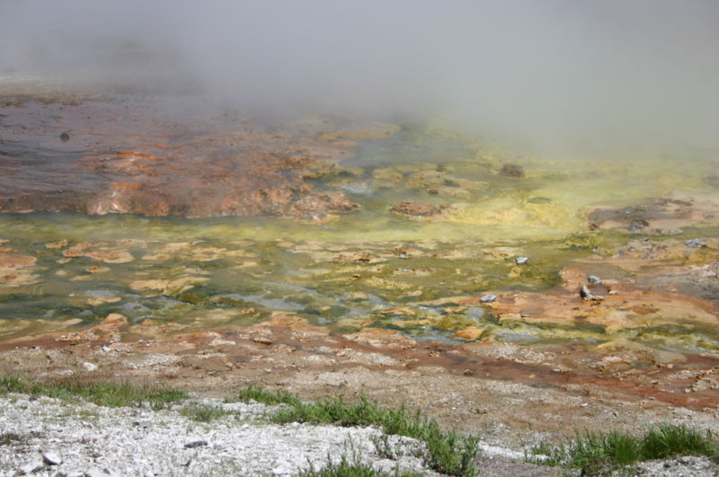
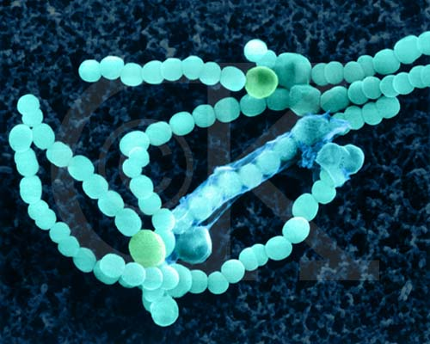
Archaebacteria
Archaebacteria that live in these geysers are called thermophiles
(heat-loving)
Midway Geyser Basin
– Yellowstone National Park

Slide 44
Eubacteria (“true” bacteria)
Number of identified species: 9,000
Very strong cell wall
Some are autotrophic (produce their own food – ex. Photosynthesis)
Some are heterotrophic (must take food in)

Slide 45
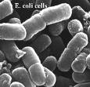

Eubacteria
Bacteria you’re most familiar with
  Streptococcus – causes strep throat
  E. coli – normally in digestive tract, can contaminate food
Most are harmless or even helpful

Slide 46
Archaebacteria and Eubacteria previously classified into same kingdom, Monera
Late 1970s – archaebacteria discovered
Fossils found that are from 3.4 billion years ago

Slide 47
Protists “Dumping Ground of Kingdoms”
Number of identified species: 200,000
Unicellular and multicellular eukaryotes
Found in moist environments
Fossils found that are from 2 billion years ago

Slide 48
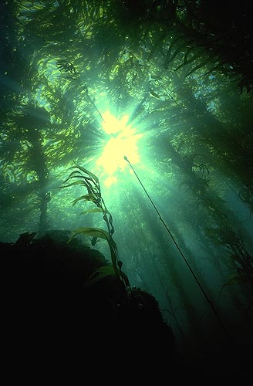
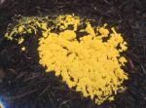
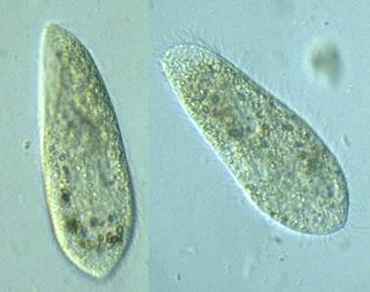
Protists
Divided into 3 groups:
Fungus-like (heterotrophs)
Ex. Slime mold – found on forest floor, decaying logs, etc.
Animal-like
(heterotrophs)
Ex. Paramecia – found in aquatic environments
Plant-like
(autotrophs)
Ex. Kelp (seaweed)-
Found in aquatic
environments

Slide 49
Fungi – Earth’s Decomposers
Number of identified species: 100,800
Unicellular and multicellular heterotrophic eukaryotes
  Obtain food by absorbing nutrients from organisms
Stationary (not mobile)
Cell walls composed of chitin

Slide 50
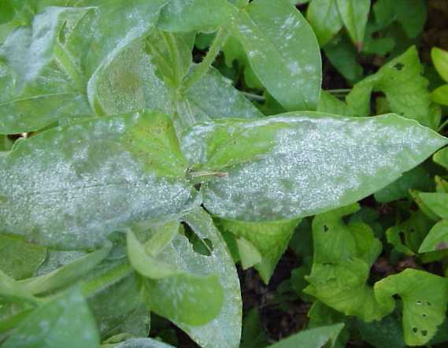
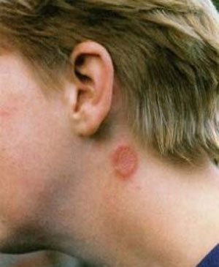
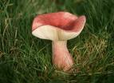
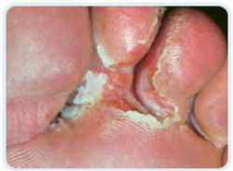
Fungi
Grouped by shape & reproduction
Ex. Mushroom, mildew, molds
Fossils found from 400 million years ago

Slide 51
Plants – Oxygen Producers
Number of identified species: 260,000
Multicellular, autotrophic eukaryotes
Cell wall of cellulose
Stationary; organ systems present
Grouped by:
seeds/spores, vascular/non-vascular
Fossils from 400 million years ago

Slide 52

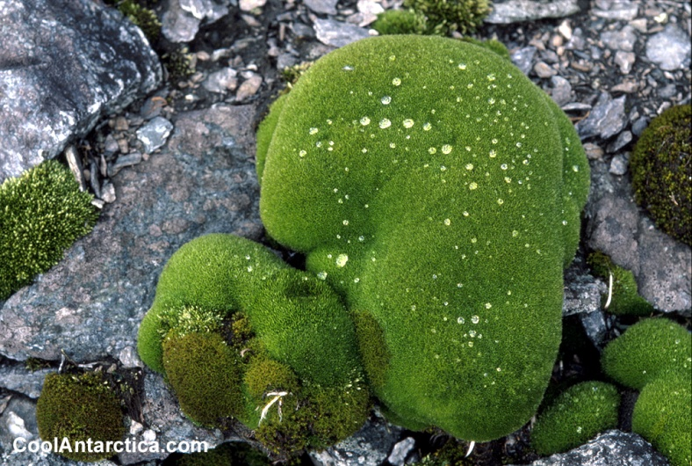
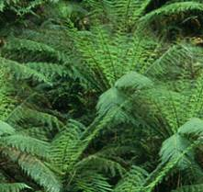



Plants
Ex. Moss, ferns, flowers, grass, shrubs, trees

Slide 53
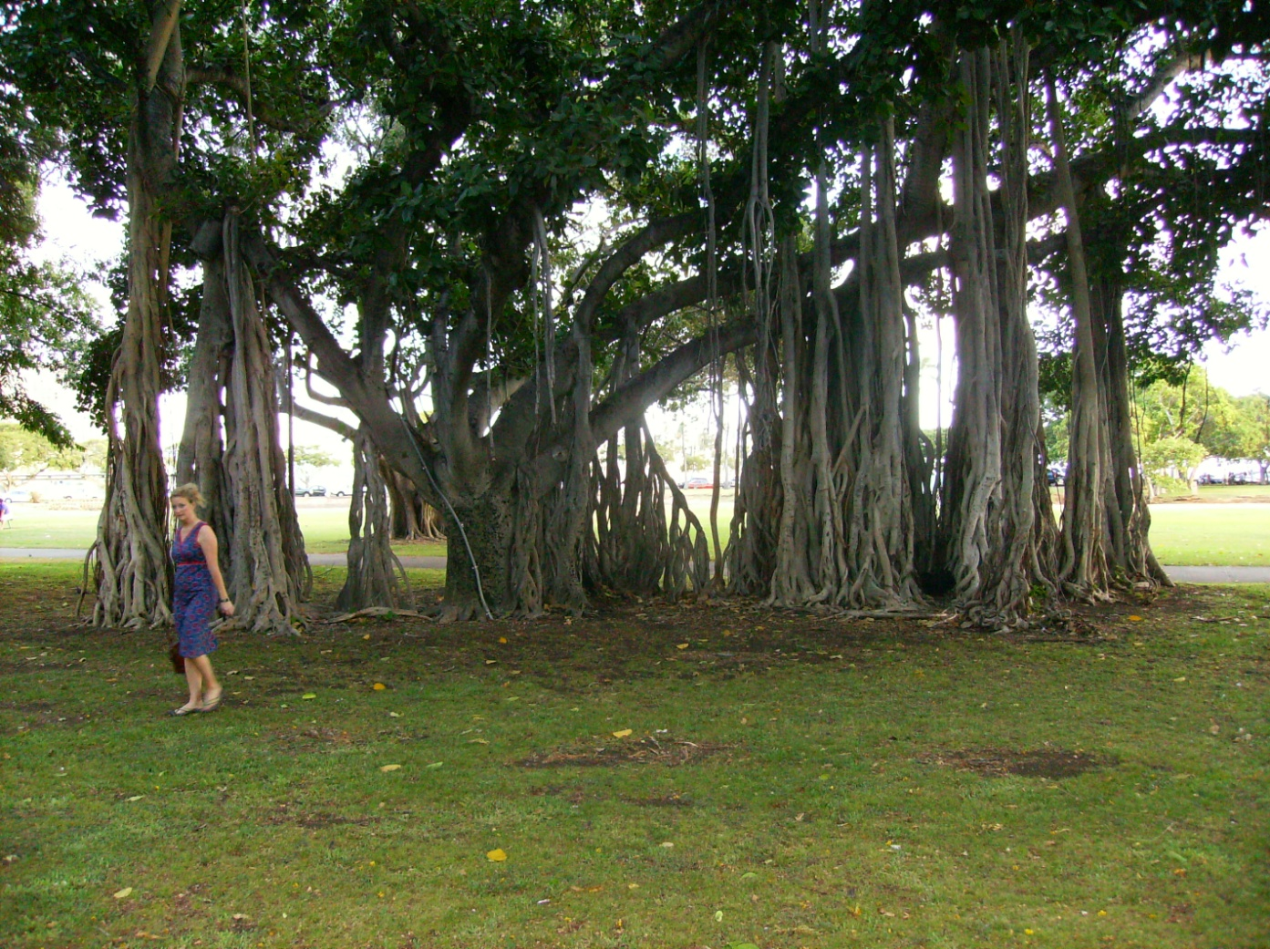
Banyan

Slide 54
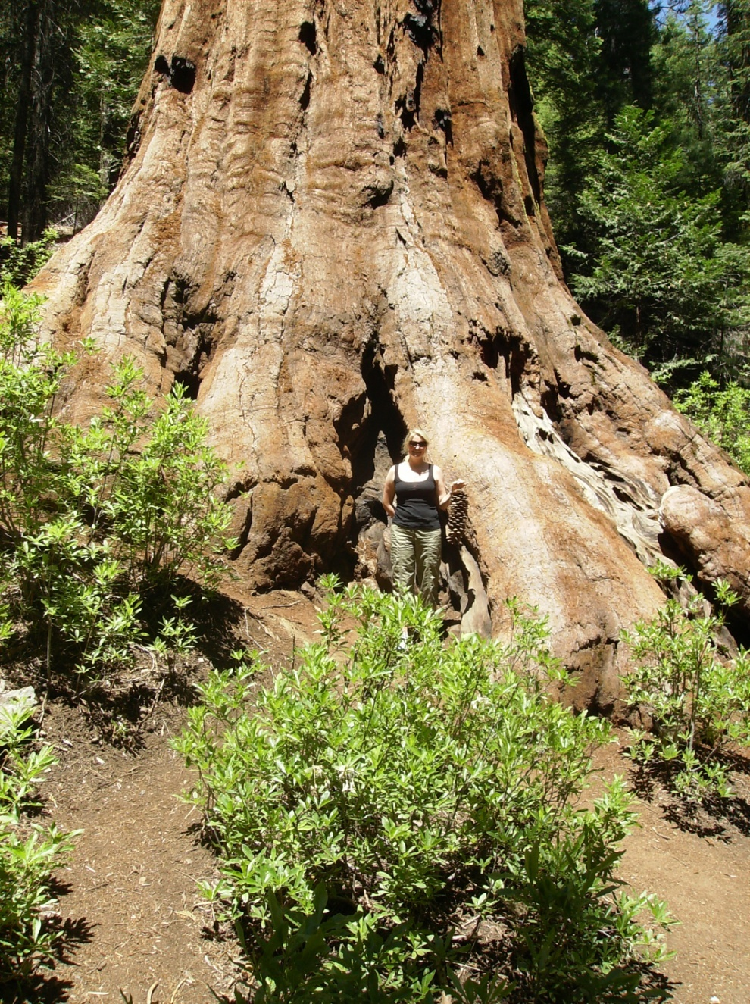

Slide 55
Animals – Mobile consumers
Number of identified species: 1.3 million
Multicellular, heterotrophic eukaryotes
No cell walls
Complex organ systems
Grouped by: symmetry, backbone, reproduction, segmented, body covering
Fossils found that are from 700 millions years ago

Slide 56

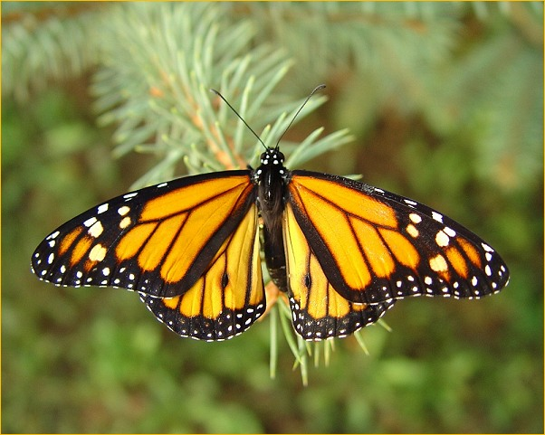
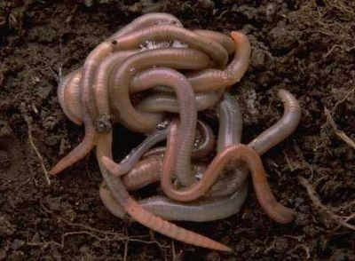
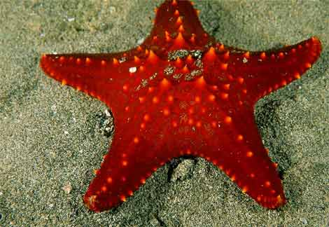
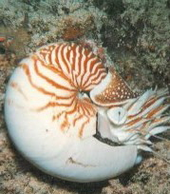
Animals
Sponges, jellyfish, worms, insects, mollusks, starfish, vertebrates

Slide 57
Dichotomous Keys
Dichotomous Key Example
  http://www.biologycorner.com/bio1/taxonomy.html
Now it’s your turn!
  http://www.nclark.net/Classification

